Slide 1
Information Security Back to Basics
Avoiding an Information Security Mis-management Program through
IT Fundamentals

Slide 2
What shall we talk about
Are information security programs learning the lessons from organizations in the news? Probably not, as many of the reported breaches are due to failures of basic information technology processes. Simply put, organizations are failing at fundamental security tasks which if implemented would lead to fewer breaches and greater security for their data.
We will explore the basics, why they matter, and when failure to implement the basics led to breaches.

Slide 3
Problem Statement: Organizations are not covering basic controls
T.J.Maxx (2005)
Anthem (2014)
Community Health System (2014)
Equifax (2017)
Nuance (2017)

Slide 4
T.J.Maxx - 2005
Largest compromise of credit and debit card numbers at the time
45.6 card numbers stolen over an 18 month period
Attackers exploited outdated encryption technologies to access transaction information
Old information from returns without receipts still in system.
https://www.computerworld.com/article/2544306/security0/tjx-data-breach--at-45-6m-card-numbers--it-s-the-biggest-ever.html

Slide 5
Anthem - 2014
One of the largest health insurance providers in the US
Health care data breach affecting 80 million customers
Attackers stole credentials for privileged access to databases and stole data over a period of months
http://www.csoonline.com/article/2881532/business-continuity/anthem-how-does-a-breach-like-this-happen.html

Slide 6
Community Health Systems - 2014
4.5 Million Records Stolen
Heartbleed patches not installed on firewalls
https://www.csoonline.com/article/2466726/data-protection/data-protection-heartbleed-to-blame-for-community-health-systems-breach.html

Slide 7
Equifax - 2017
One of the largest data breaches in history – 143 million records (and counting)
Attackers gained access multiple times
Primary breach was an unpatched web server component

Slide 8
Nuance - 2017
Cloud services provider for dictation and transcription of medical records
Network completely shut down in Summer 2017 due to NotPetya “ransomware”
Systems were affected through a combination of privileged access, segmentation, and patching errors
https://histalk2.com/2017/08/30/readers-write-malware-lessons-shared-seven-key-questions-for-health-leaders-to-ask-about-cyber-preparedness/

Slide 9
"Next generation" threat is a marketing term
There are APTs but they are only as sophisticated as they need to be
China probably isn’t going to use an iPhone 0-day on you going on your family vacation to Disney World
Penetration testers aren’t usually using exploits either
Notes:
Attackers aren’t using exploits all the time to gain access.
They are using low privileged user accounts to gain access to other accounts and moving laterally until they can gain access to a privileged access account.
“The Hooded Hacker” is a joke within a joke. Articles and marketing materials always add the hooded hacker picture

Slide 10
Threat intelligence is interesting, but…
It’s beyond the needs of most orgs
All the threat intel in the world doesn’t patch your boxes
Threat intel can be good, but does it complicate your information security strategy?
Notes:
Norse Corporation had great threat intelligence maps, but went out of business

Slide 11
What are the basics?

Slide 12
Center for Internet Security Top 5 Critical Security Controls
Inventory of Authorized and Unauthorized Devices
Count your devices
Inventory of Authorized and Unauthorized Software
Count the software and whitelist only what is needed
Secure Configurations for Hardware and Software on Mobile Devices, Laptops, Workstations, and Servers
Harden using industry-accepted standards (CIS Benchmarks, DISA STIGs)
Continuous Vulnerability Assessment and Remediation
Patch everything, remediate other vulnerabilities in configuration
Controlled Use of Administrative Privileges
Limit local administrator and privileged accounts in the network

Slide 13
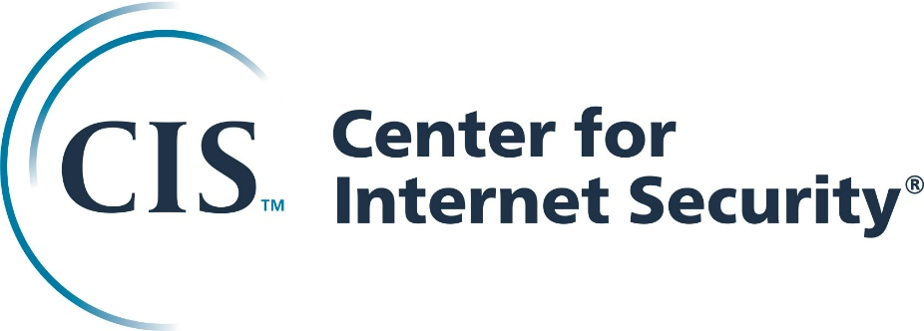
About the CIS Top 5 (and 20)
We talked about the Top 5, but there are 15 others
CIS Top 20 is a prioritized control framework model based on real-world attacks
The Top 5 provides an defense against the 85% of the most common cyber attacks
https://learn.cisecurity.org/first-five-controls-download

Slide 14
How do the Top 5 Relate to the Big Breaches?
Recap of breach findings:
Primary breach was an unpatched web server component
Systems were affected through a combination of privileged access, segmentation, and patching errors or unsupported technology
Heartbleed patches not installed on firewalls
Attackers stole credentials for privileged access to databases and stole data over a period of months
Notes:
Point out that while patching and privileged access are the main causes here, you can’t patch what you aren’t counting.

Slide 15
Why does CIS matter to your organization?
It’s a roadmap for where to start
Actionable steps for implementation
Maps to HIPAA, NIST, HITRUST, PCI

Slide 16
What’s after the Top 5?
Network Segmentation
If you can’t patch it, securely segment it
Medical devices, old computers
If you can patch it, securely segment it
PCI Cardholder Data Environment, Accounting systems, management networks
“The Crown Jewels”
Notes:
Although the watertight bulkheads extended well above the water line, they were not sealed at the top. If too many compartments were flooded, the ship's bow would settle deeper in the water, and water would spill from one compartment to the next in sequence, rather like water spilling across the top of an ice cube tray. This was what happened to Titanic, which had suffered damage to the forepeak tank, the three forward holds and No. 6 boiler room, a total of five compartments. Titanic was only designed to float with any two compartments flooded, but it could remain afloat with certain combinations of three or even four compartments (the first four) open to the ocean. With five compartments, the tops of the bulkheads would be submerged and the ship would continue to flood.

Slide 17
What’s after the Top 5?
Multi-factor Authentication
Remote Access
Privileged Access

Slide 18
How do you secure the Cloud?
Other people computers, follow their rules
Be a thoughtful guest
Identity and Access Management
Identity is the primary perimeter you can control
Just stop with public buckets
Notes:
Public buckets are a source of many recent breaches. 200M voter records, sensitive CIA and Army intelligence, and Citibank employee data were all found in public buckets with no access restrictions. Search engines exist that can be used to hunt for public buckets.

Slide 19
Step 0: Information Security Management
Accountable to Senior-most leader
MGMT <-> BIZ <-> Security
What business initiative are you working to address?
What problem are you trying to solve?
IS Transitioning from "Department of No" to "Department of How"
Inventory your controls
SynerComm CIS Top 20 Tool Inventory Spreadsheet
AuditScripts CIS Top 20 Tool
Notes:
“What business initiative are you working to address?” should align to specific business needs
“What problem are you trying to solve?” should be a question to ask for every tool and process you’re adding to the environment

